Slide 1
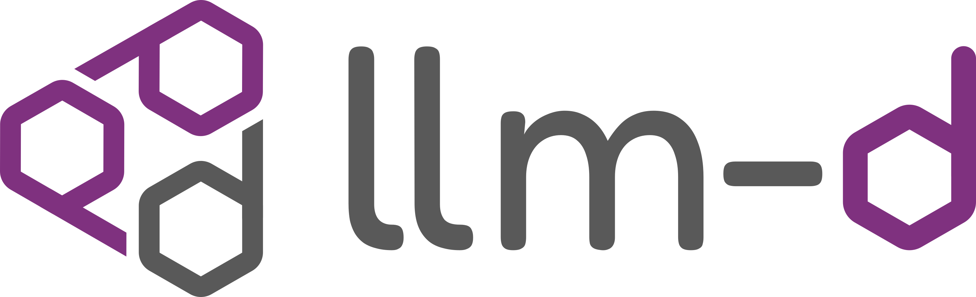



Mooncake × llm-d
Agentic AI 时代搭建高性能推理集群
Building High-Performance Inference Clusters in the Era of Agentic AI
卢佳豪 趋境科技技术专家 | Mooncake 核心贡献者
Jiahao Lu, Approaching.AI Tech Expert | Mooncake Core Contributor
5.23 vLLM Meetup; Hangzhou, Zhejiang

Slide 2
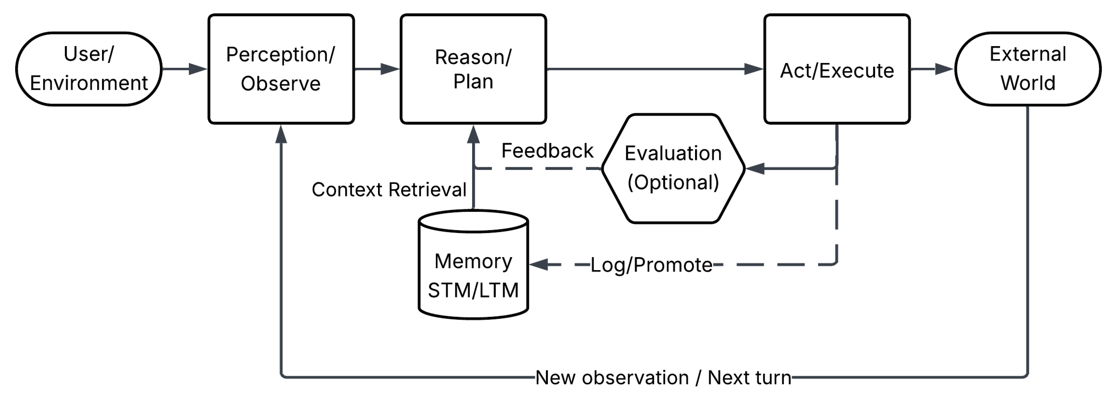
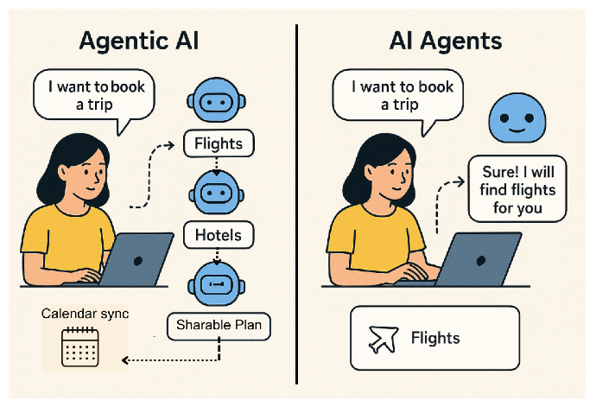
From Generative AI to Agentic AI
Human Action
AI Action
Generative AI
Agentic AI
You drive every step.
You decide what happens next.
You set a goal.
The agents drive the work.
You set a goal
You write a prompt
Agent plans steps
AI generates output
Agent acts with tools
self-corrects until done
You review and edit
repeat util good enough
Agent evaluates results
You refine the prompt
Agent delivers
finished result
You use the output
You review the outcome
[1] Agentic AI vs. Generative AI: What’s the Difference, and Why Does It Matter?
[2] The Rise of Agentic AI: A Review of Definitions, Frameworks, Architectures, Applications, Evaluation Metrics, and Challenges

Slide 3
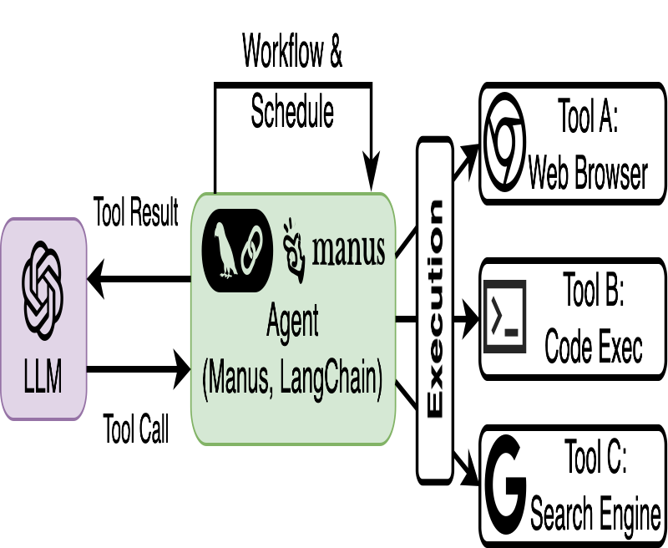
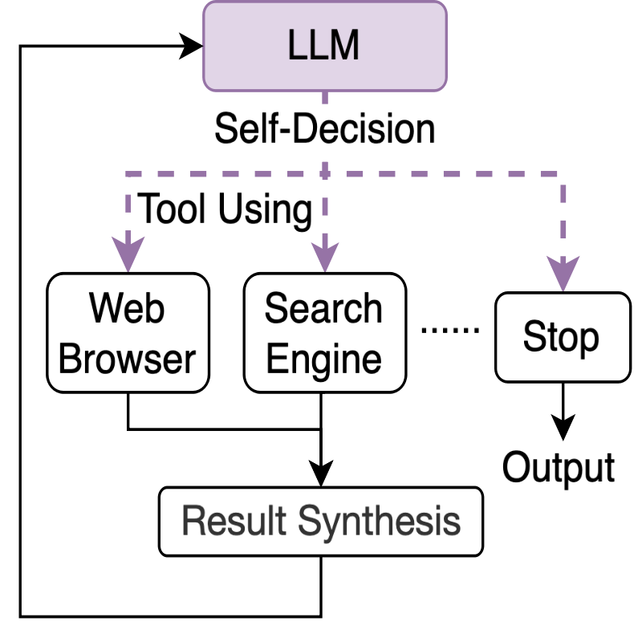
The Monster in The Agentic AI Era: Large Context
Long-Horizon, Multi-Turn Agentic Loops → Large Context
94.2% Cache Hit Rate^{[1]} 131:1 input-to-output ratio^{[1]}
Small Deltas, Large Prefixes → KV-Cache Reuse Opportunity
Mooncake:Trading More Storage for Less Computation
[1] https://vllm.ai/blog/mooncake-store

Slide 4
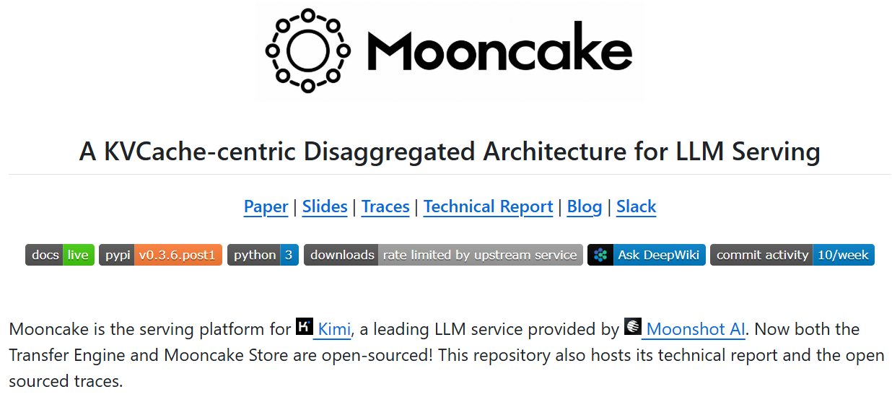


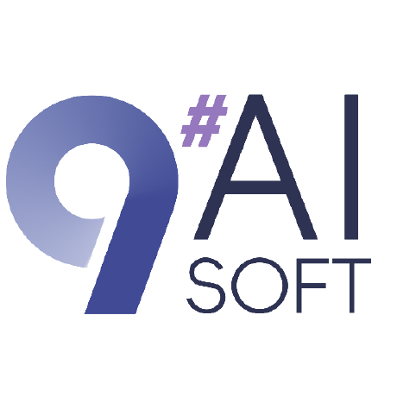





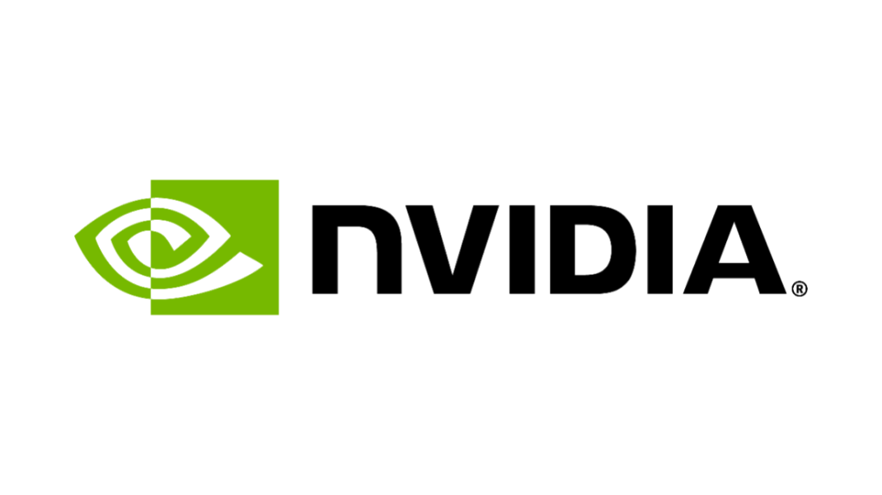


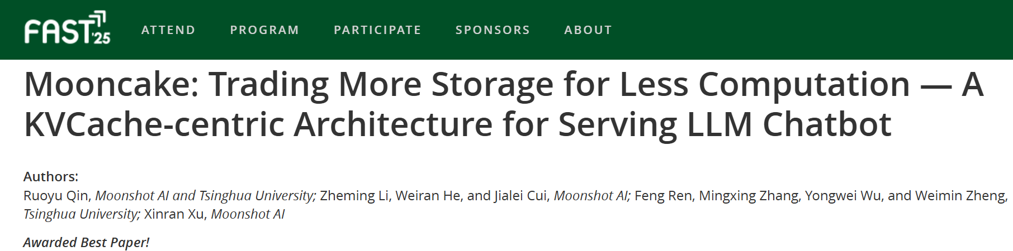
The Opportunity: Open-Sourced Mooncake
[1] Mooncake: Trading More Storage for Less Computation — A KVCache-centric Architecture for Serving LLM Chatbot (FAST’25)

Slide 5
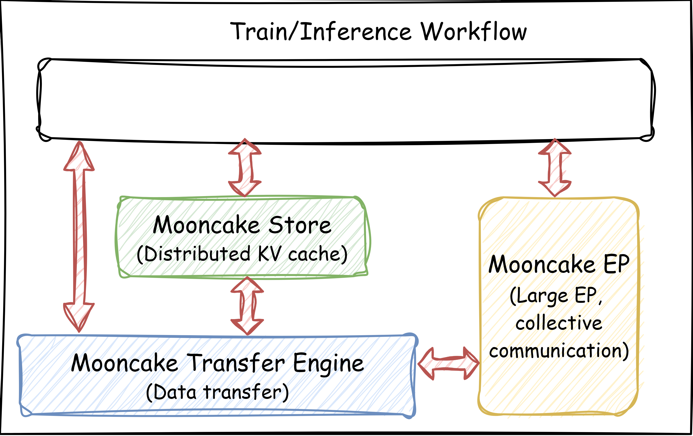



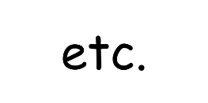


Mooncake: KVCache-Centric LLM Serving Architecture
End-to-end zero-copy
Mooncake Transfer Engine (TE/TENT)
⚡ Transfer Fast
High-performance distributed
KV cache storage
📚 Store More
✅ Easy to Use
Elastic, Shared, and Multi-layer KV Cache
Memory Allocator Optimized for LLM Inference
Extensive and user-friendly APIs
What will be introduced today ?
(1) Mooncake Transfer Engine NEXT (TENT)
(2) Mooncake Store with SSD Offloading / Pooling
(3) Mooncake x llm-d / Mooncake x vLLM
[1] Mooncake: Trading More Storage for Less Computation — A KVCache-centric Architecture for Serving LLM Chatbot (FAST’25)

Slide 6
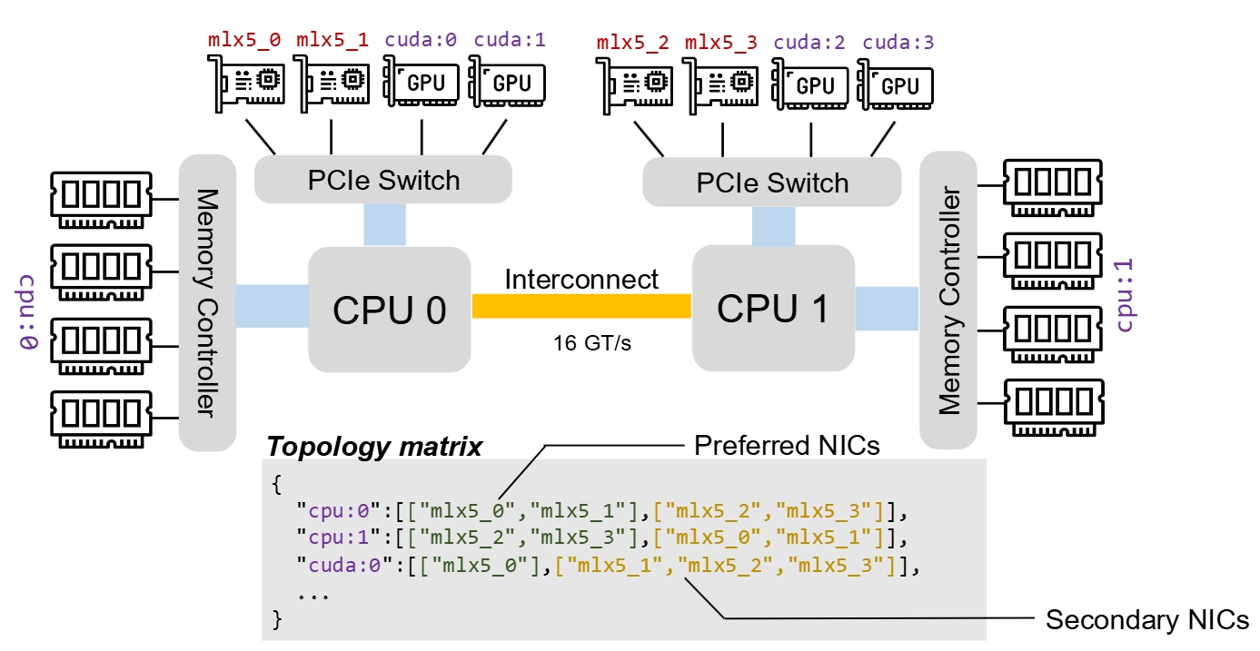
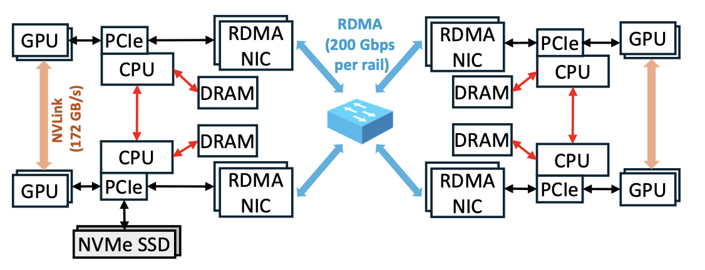
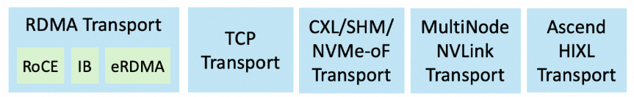
Mooncake Transfer Engine NEXT (TENT) Transfer Fast
Original Mooncake Transfer Engine
Heterogeneous Storage Interconnect
HIP
Transport
Barex
Transport
Topology-aware path selection
Multi-NIC pooling
Supports multiple protocols and provides
unified interfaces.
Heterogeneous
Static binding creates communication silos
State-blind striping wastes multi-rail bandwidth
Fragile execution demands manual intervention
[1] TENT: A Declarative Slice Spraying Engine for Performant and Resilient Data Movement in Disaggregated LLM Serving (arXiv)

Slide 7
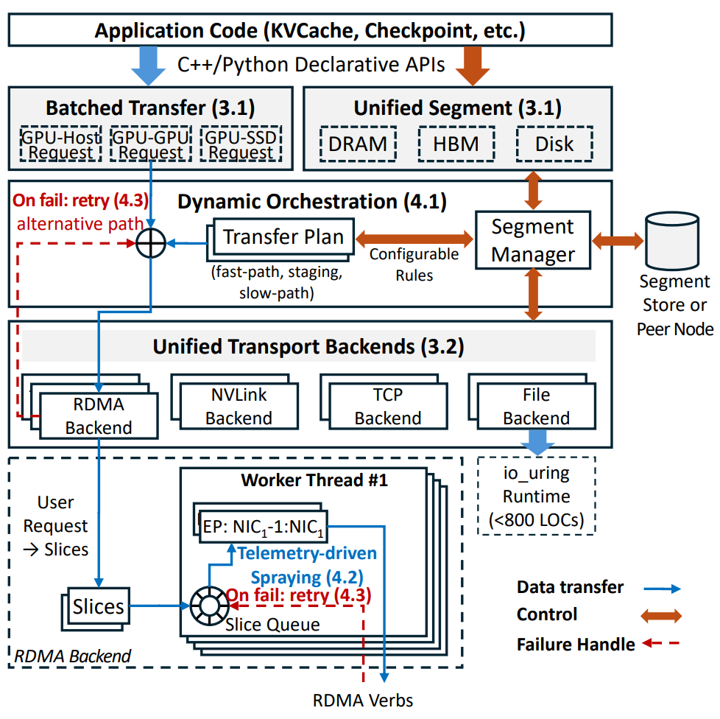
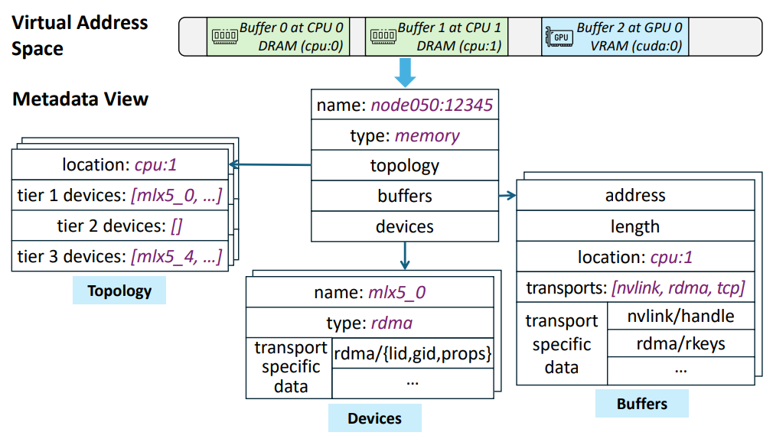
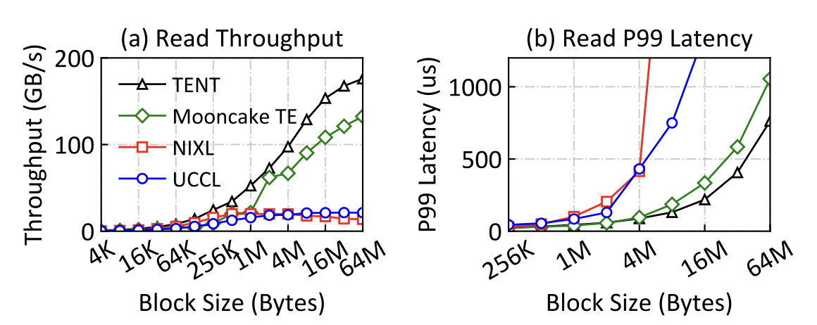
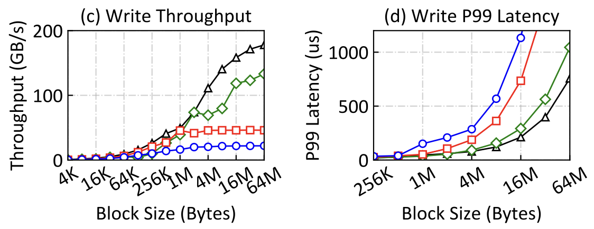
Mooncake Transfer Engine NEXT (TENT)
Passive Communication Library → Proactive Orchestrator
From Static Binding to Dynamic Orchestration
From State-Blind Striping to Telemetry-Driven Slice Spraying
From Brittle Execution to Resilient Self-Healing
[1] TENT: A Declarative Slice Spraying Engine for Performant and Resilient Data Movement in Disaggregated LLM Serving (arXiv)

Slide 8
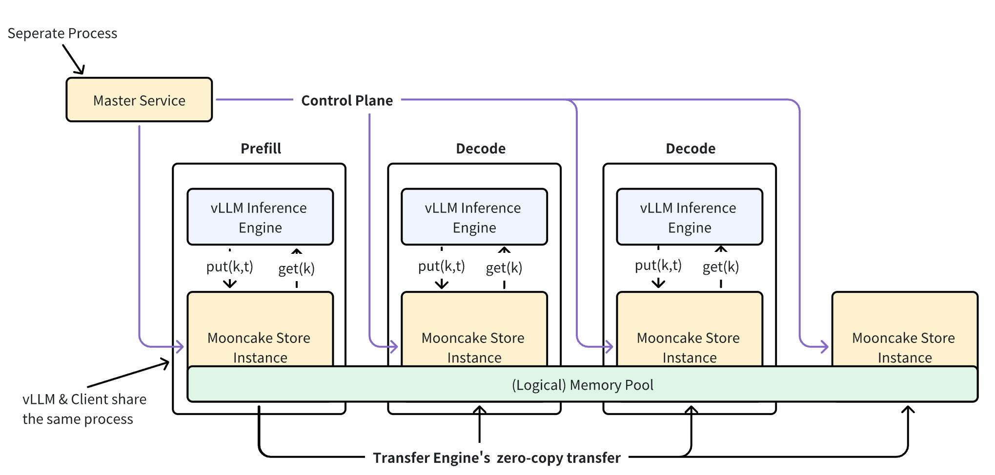
Mooncake Store Store More, Cost-Efficiently
Mooncake Store is a high-performance distributed KV cache storage engine
Object-level storage operations
Multi-replica support
Multi-layer storage support
DDR prices remain elevated; massive Agentic AI contexts drive escalating cache demands;
SSD offloading emerges as a cost-efficient solution !
[1] https://kvcache-ai.github.io/Mooncake/design/mooncake-store.html

Slide 9
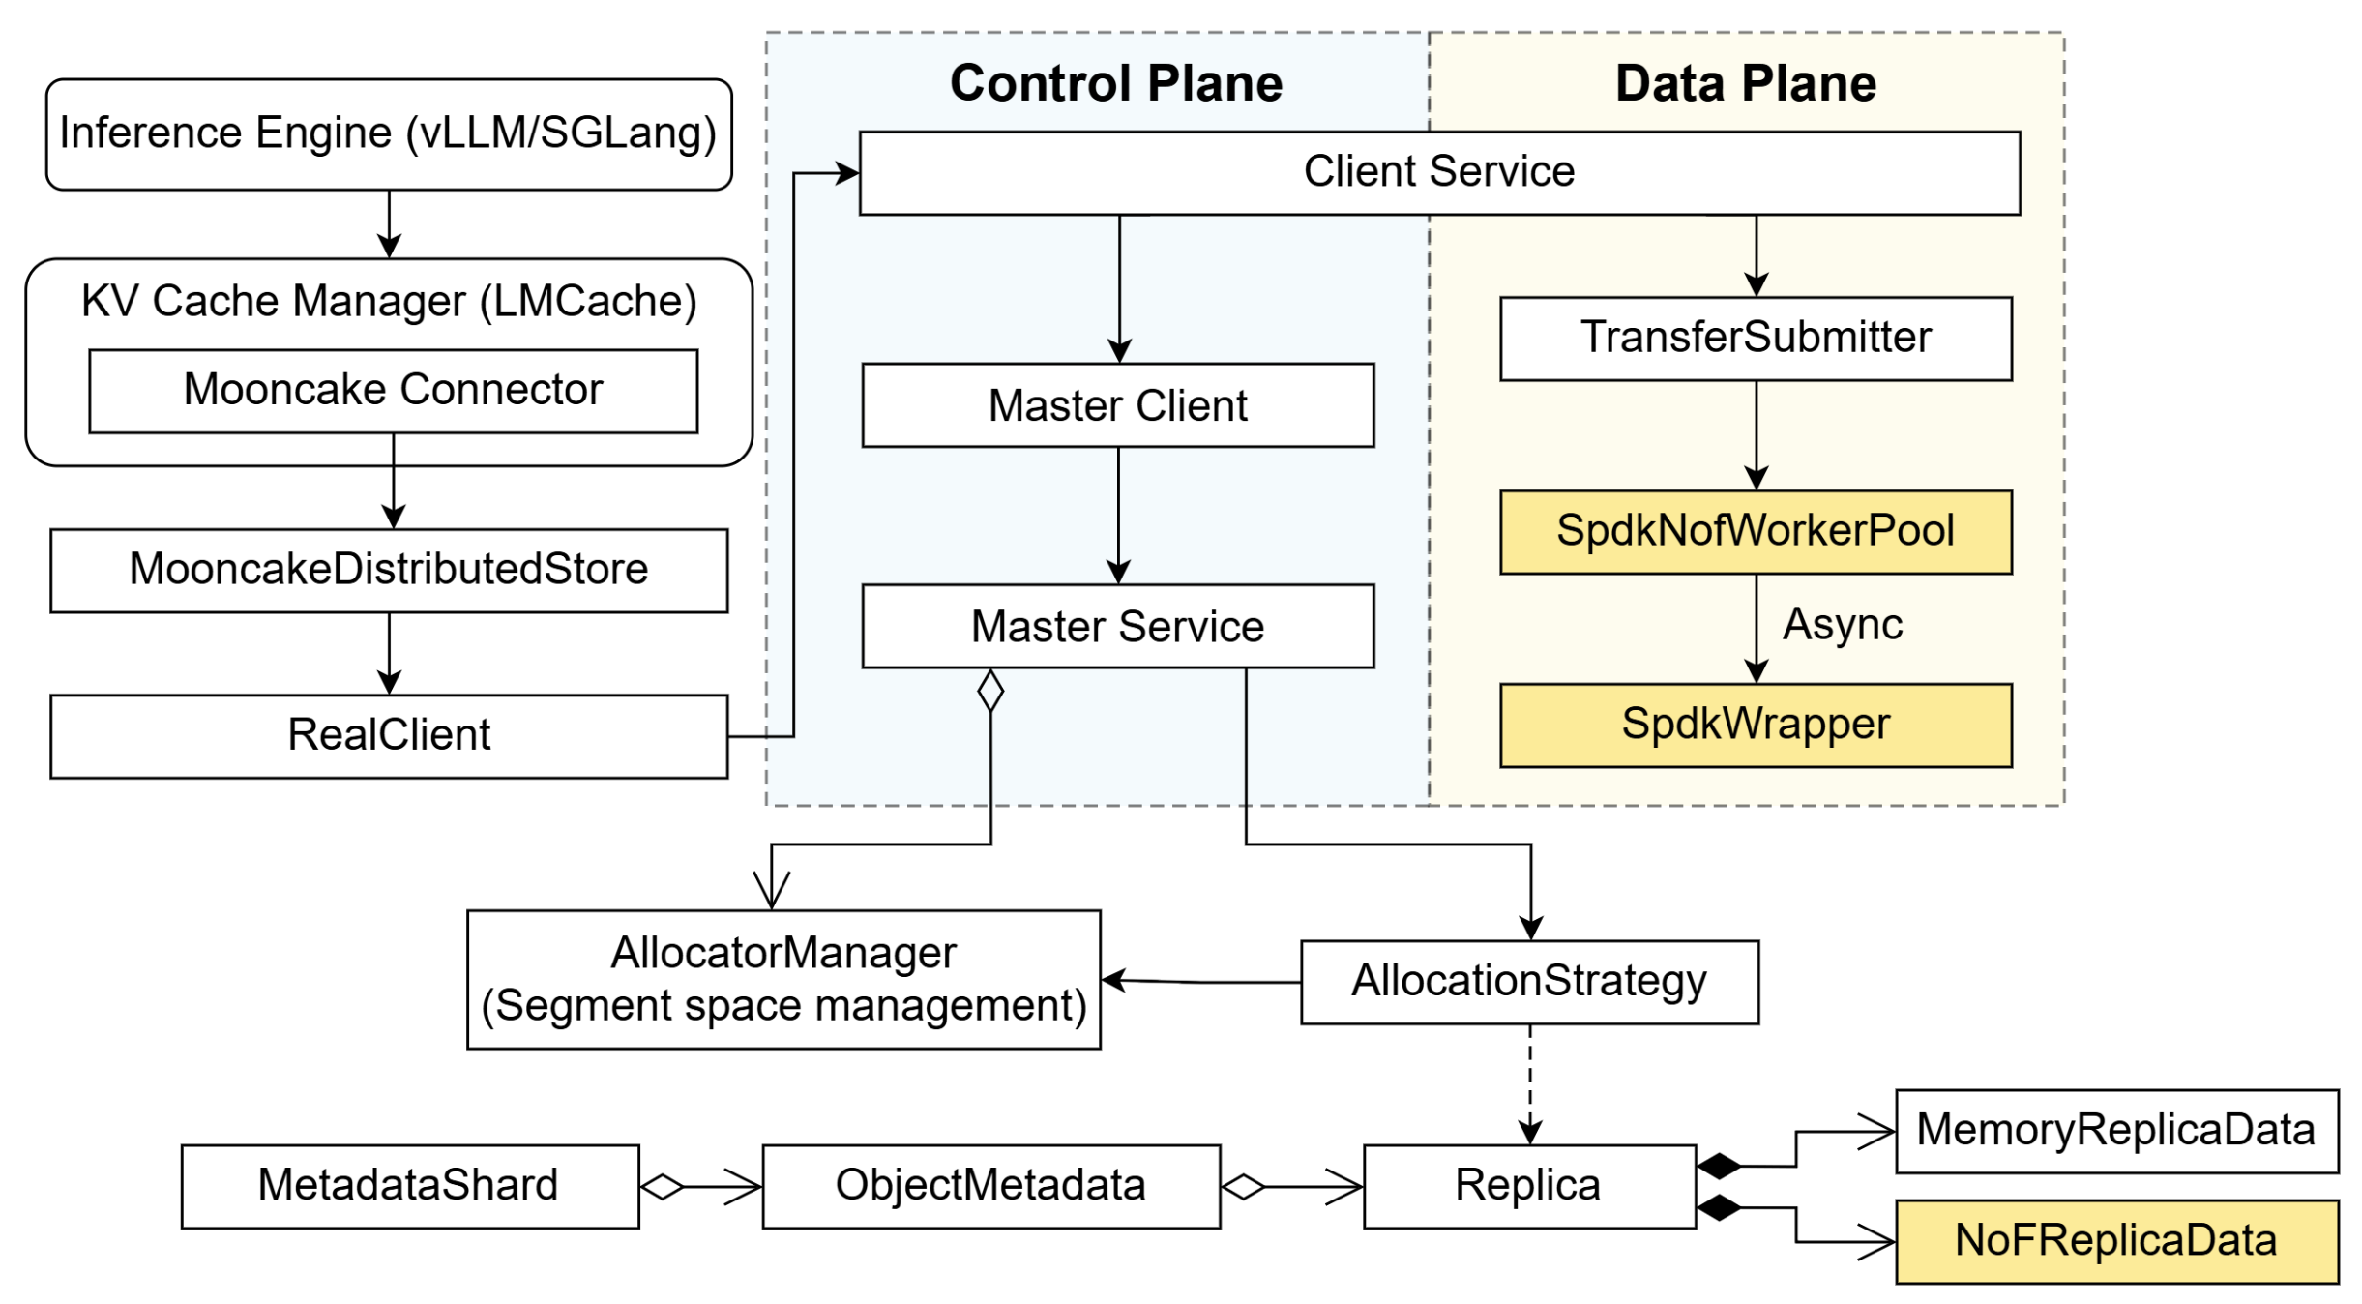
Mooncake Store: SSD offloading Store More, Cost-Efficiently
File System + io_uring (supported)
SPDK + NVMe-oF SSD Pooling (WIP)
with HUAWEI
Application (vLLM etc.)
MooncakeDistributedStore API
Inference Engine (e.g., vLLM)
Real Client
MooncakeConnector
MooncakeStoreConnector
FileStorage
Heartbeat
Thread
Staging
Buffer
offload / load
StorageBackendInterface
Bucket
Backend
FilePerKey
Backend
Offset
Allocator
Local SSD / NVMe
NVMe KV Backend (RFC now)
[1] https://kvcache-ai.github.io/Mooncake/design/ssd-offload.html [2] https://github.com/kvcache-ai/Mooncake/pull/2084

Slide 10
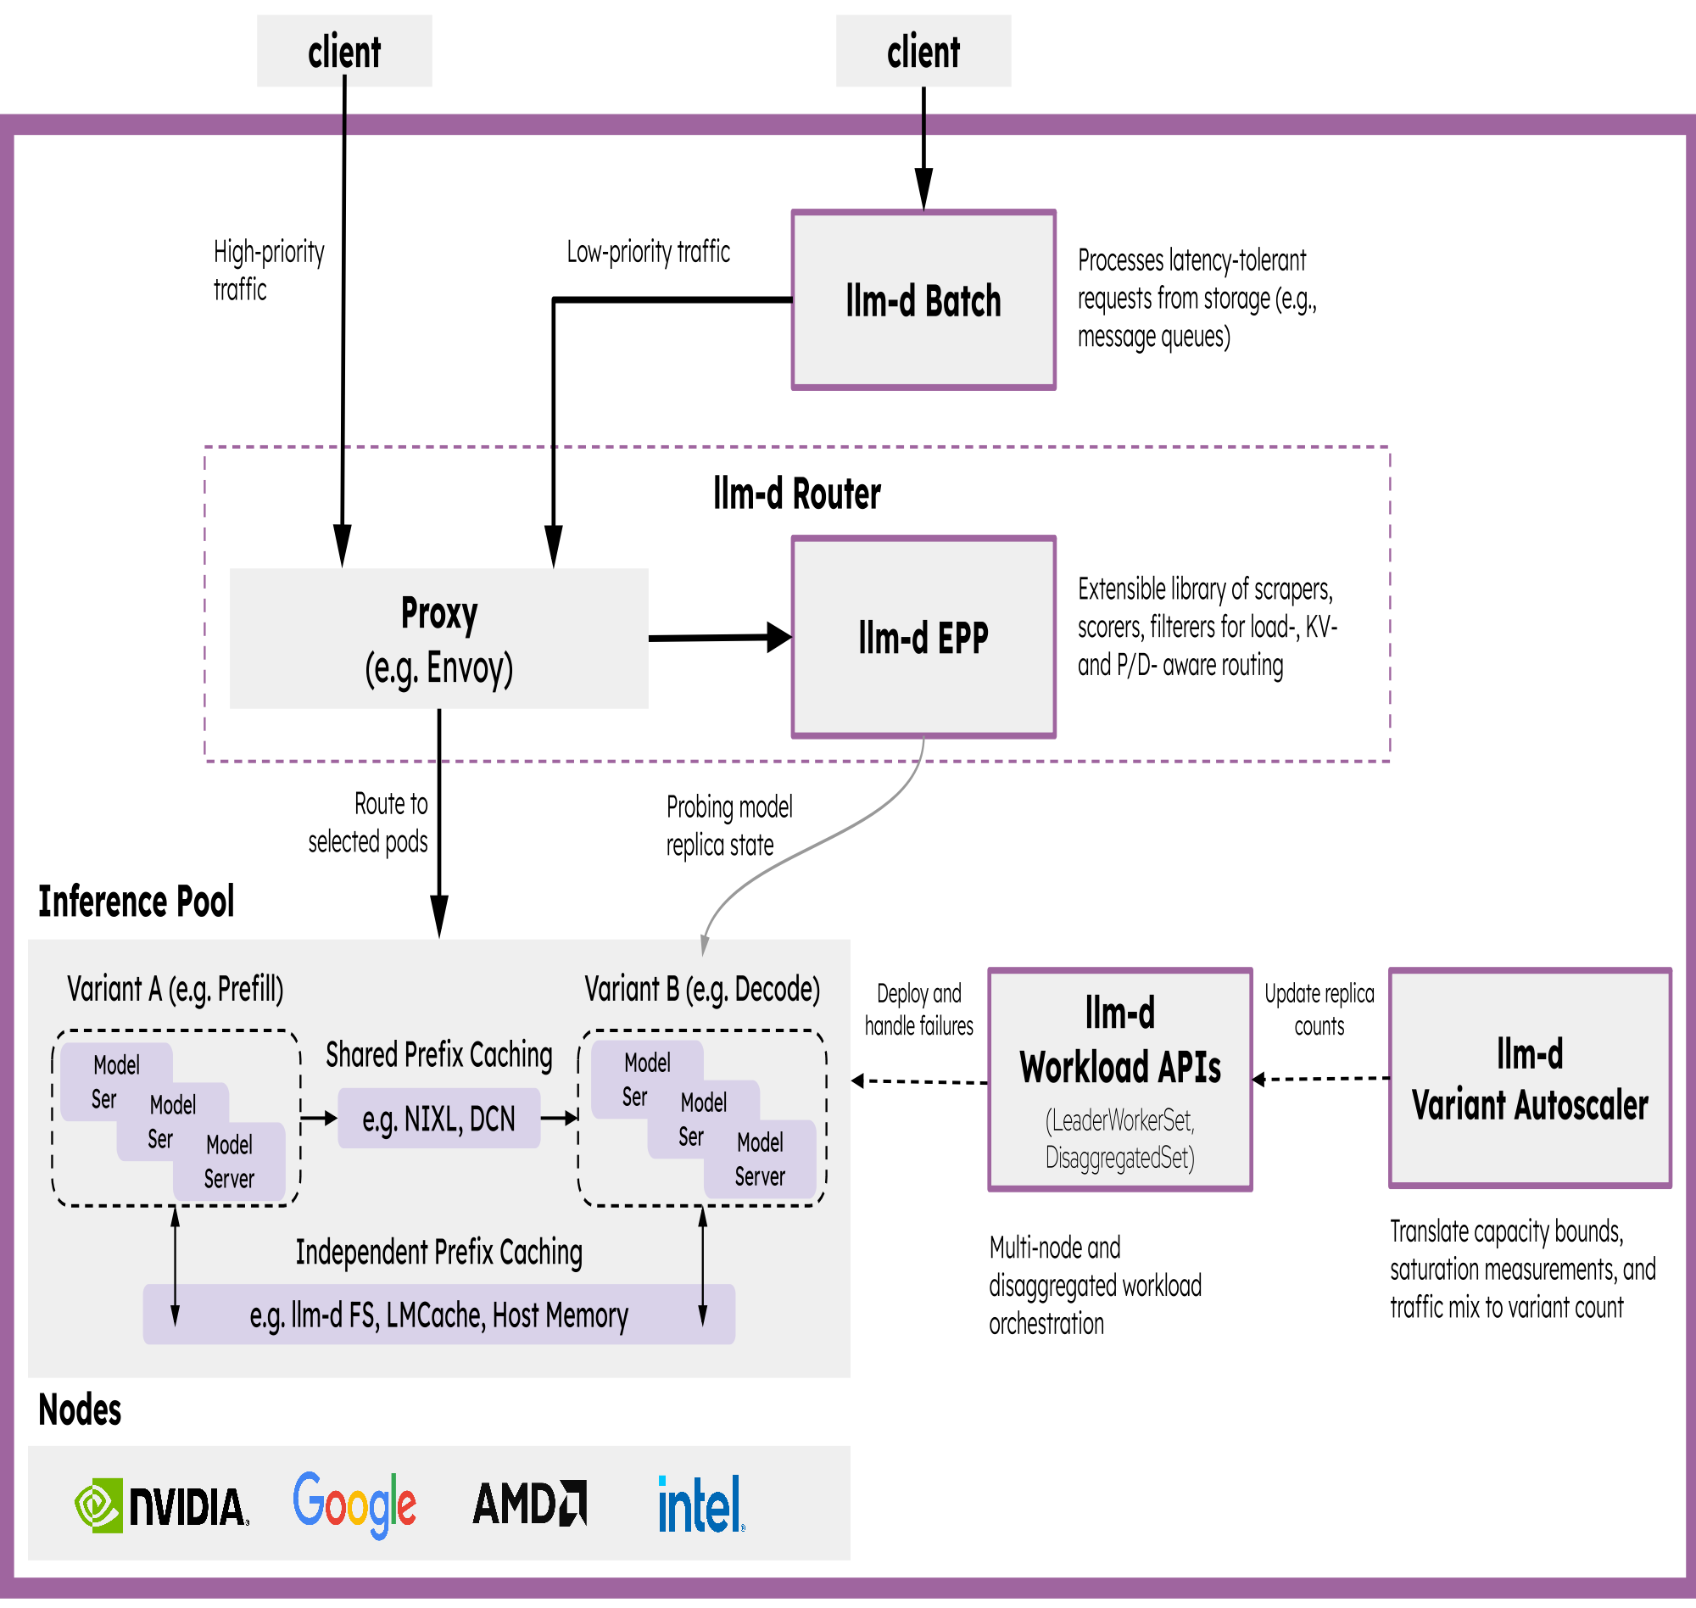
Mooncake x llm-d: Serving at Scale
Accelerating distributed inference by integrating industry-standard open technologies:
vLLM as default model server and engine,
Kubernetes Inference Gateway as control plane API and load balancing orchestrator
Kubernetes as infrastructure orchestrator and workload control plane.

Slide 11
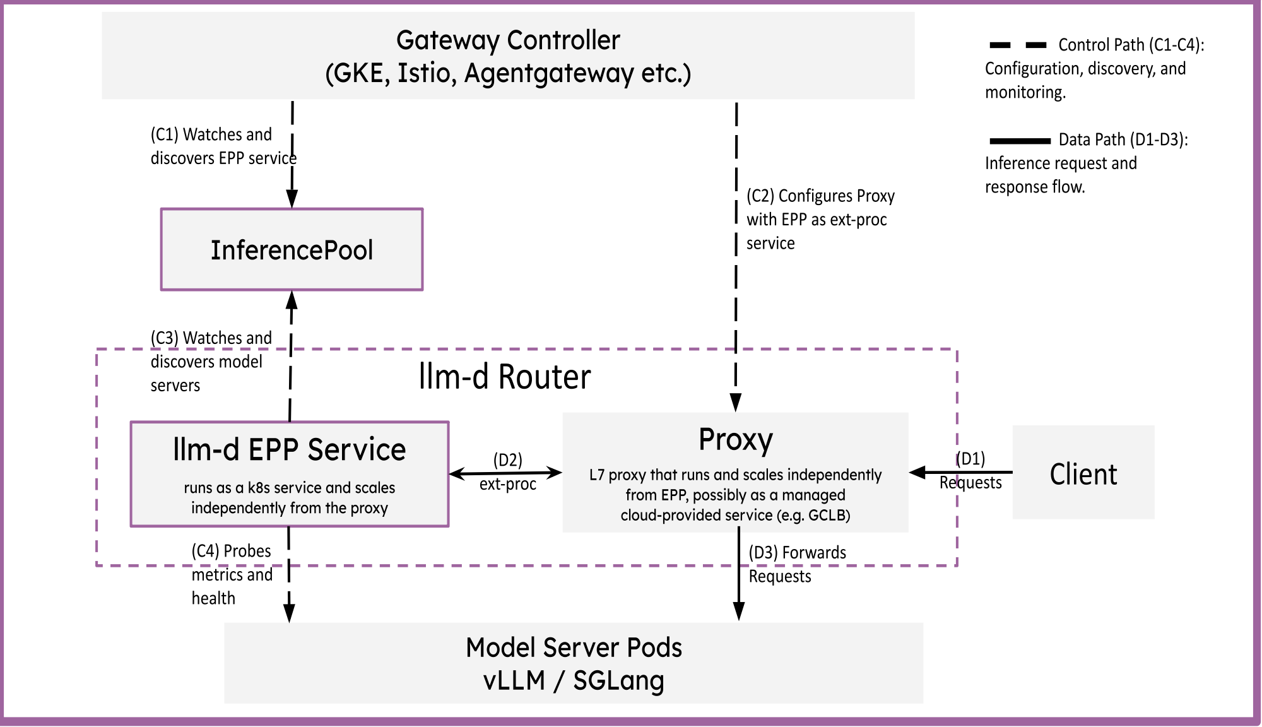
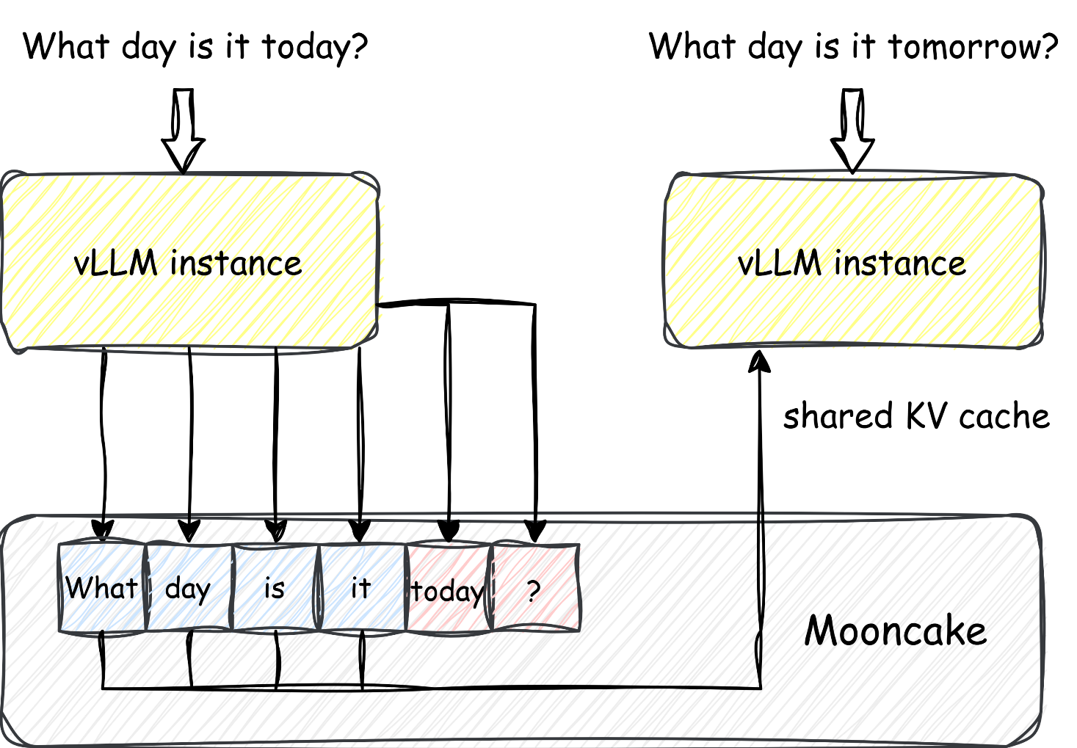
Mooncake x llm-d
Serving Agentic Workloads
（Distributed KVCache Pool）
llm-d InferencePool
Distributed KV Cache Sharing: storing one and usable by all
[1] https://github.com/llm-d/llm-d [2] https://vllm.ai/blog/mooncake-store

Slide 12
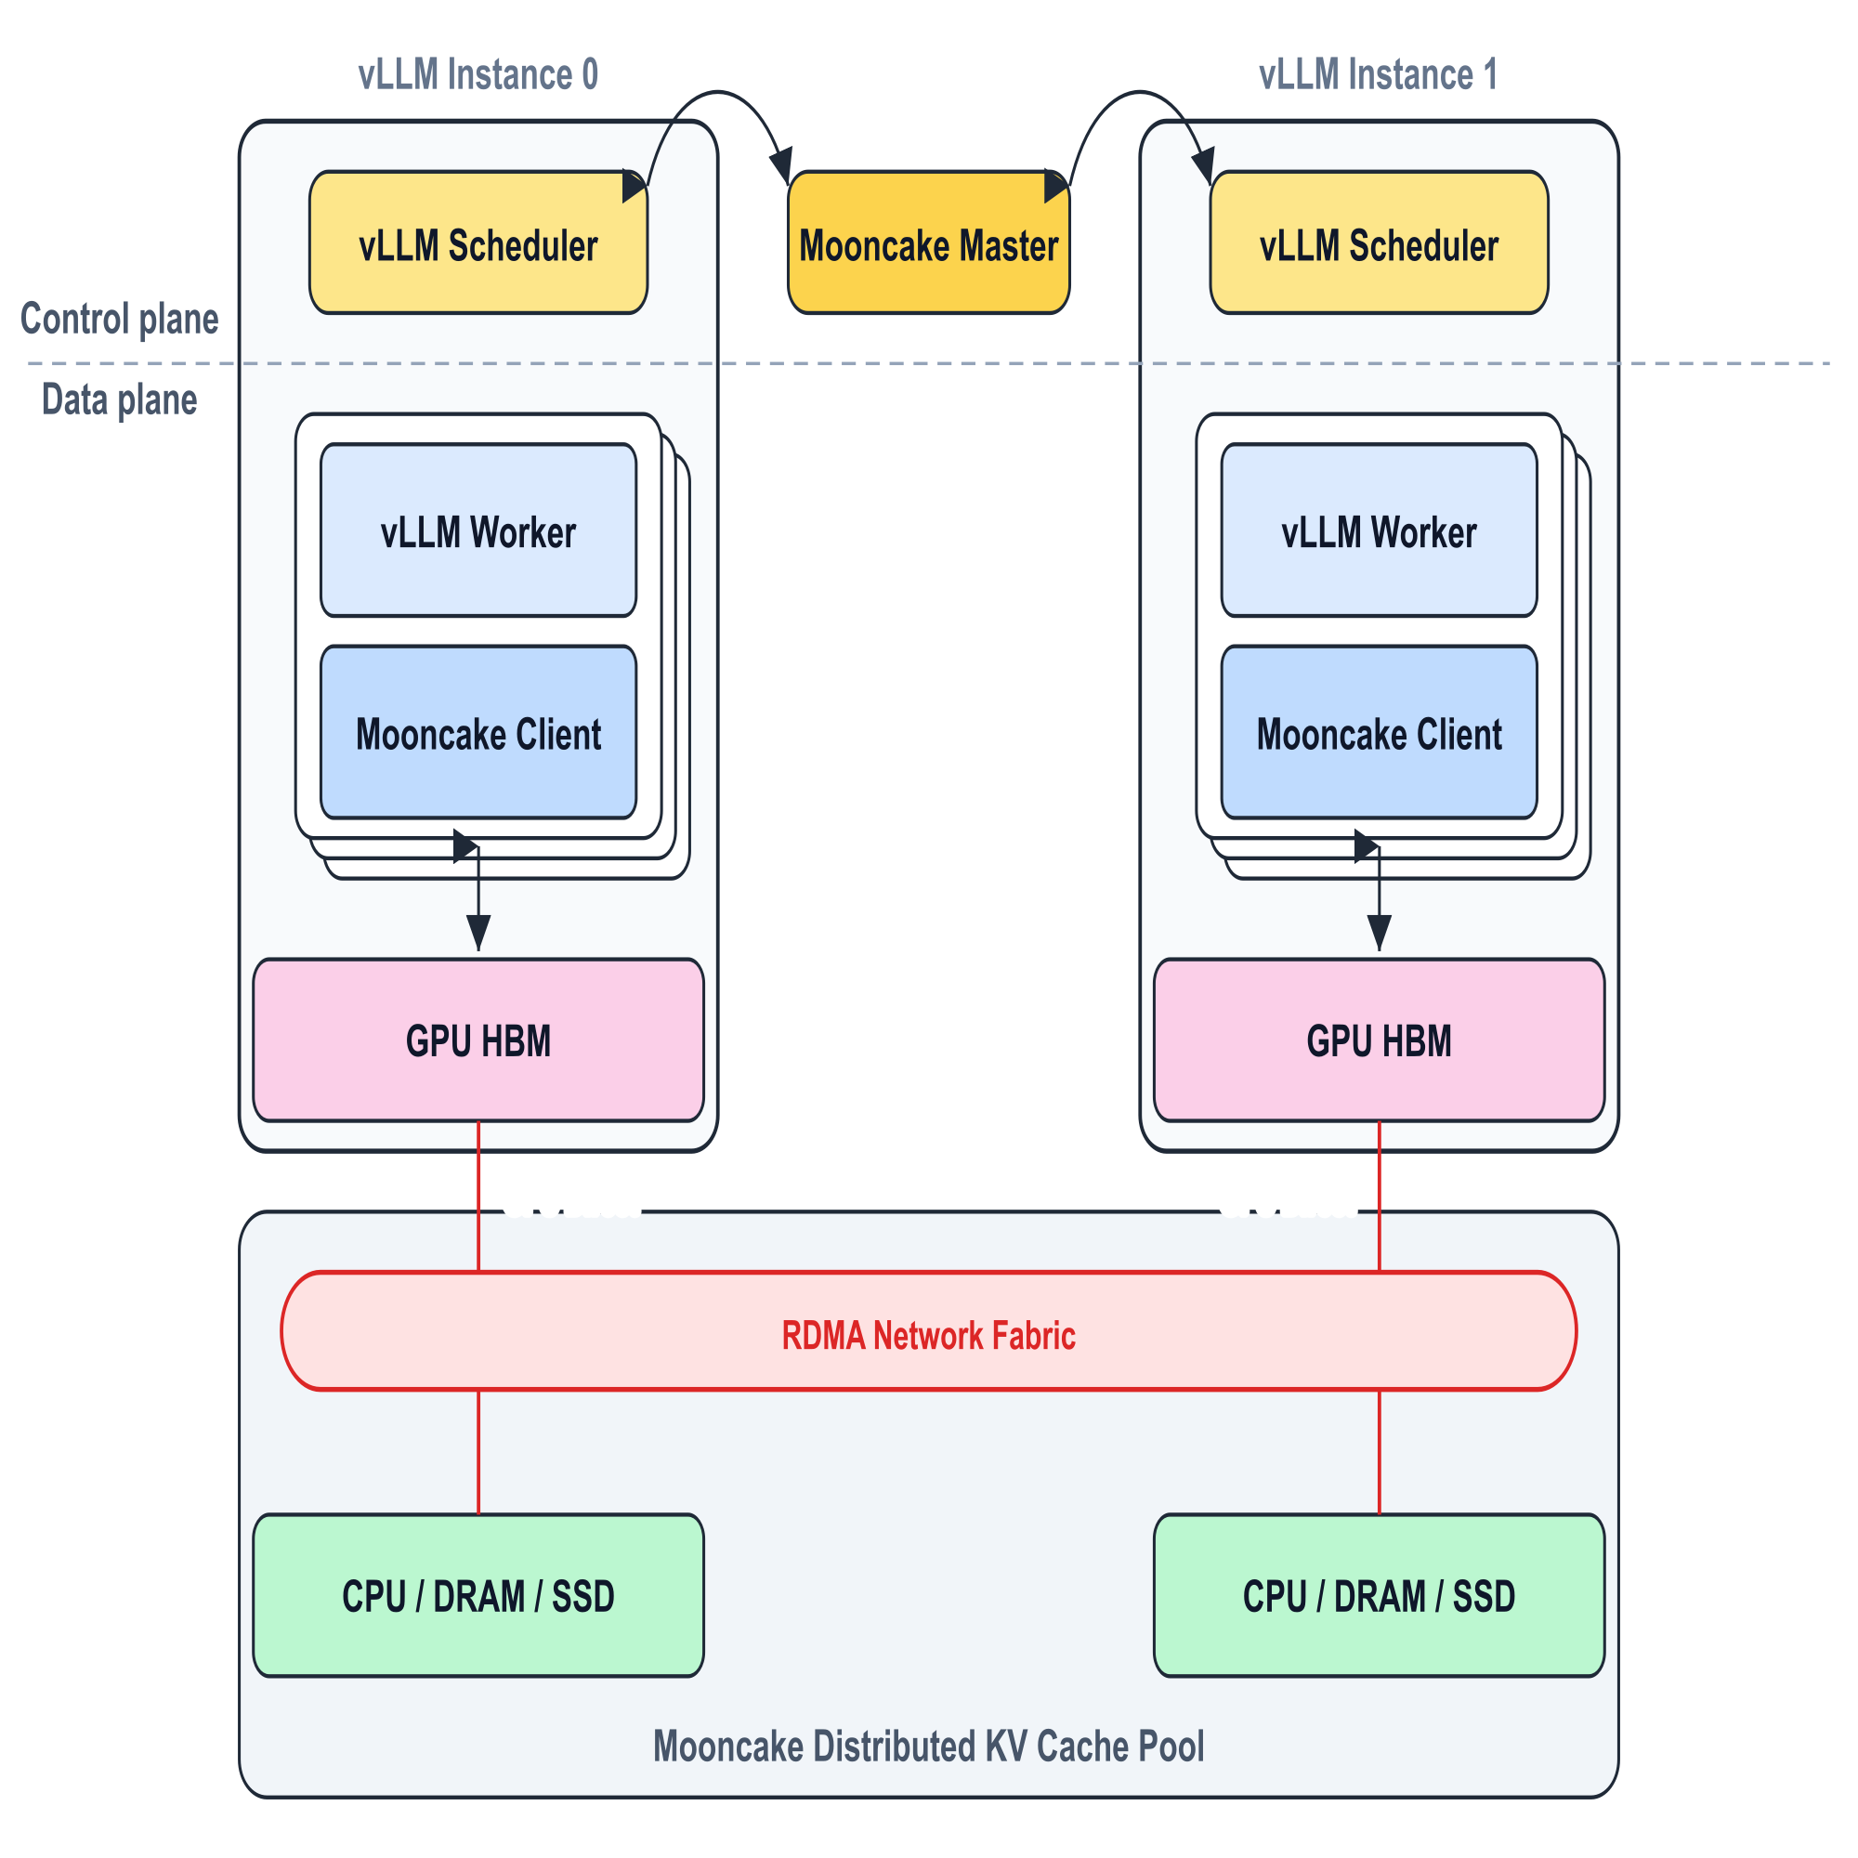
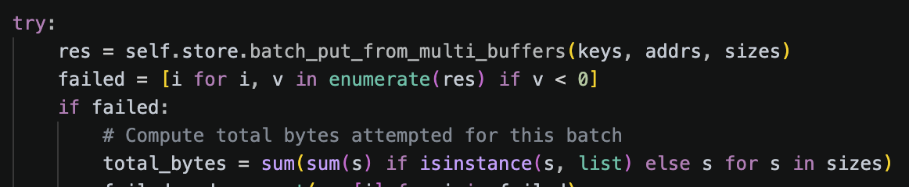
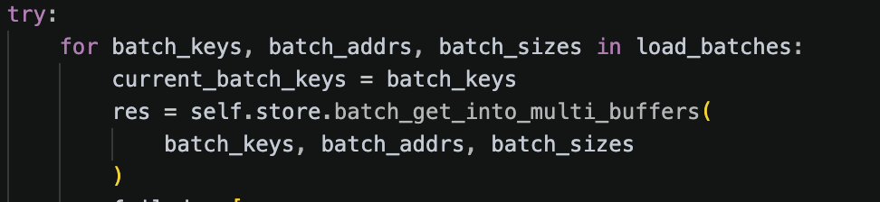
Mooncake x vLLM: MooncakeStoreConnector
vLLM instances embed Mooncake clients, sharing a cluster-wide Mooncake Store.
CPU/Disk offloading
Hash-based prefix caching across instances
Flexible deployment (kv_both / XpYd)
Qwen2.5-72B@tp_rank:0@pcp0@dcp0@pp_rank:0@a1b2c3d4e5f6...
Scheduler:
- hash, query, guide scheduling decisions.
Worker:
- zero-copy data movement.
Mooncake Support for vLLM: Rich APIs
batch_put_from / batch_get_into
batch_put_from_multi_buffers / batch_get_into_multi_buffers
......

Slide 13
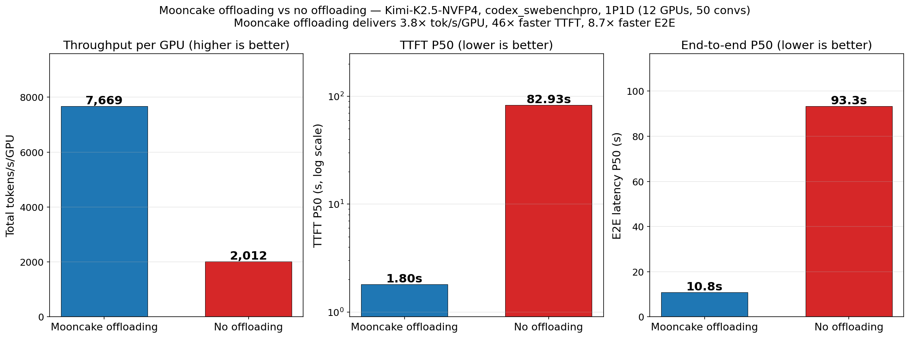
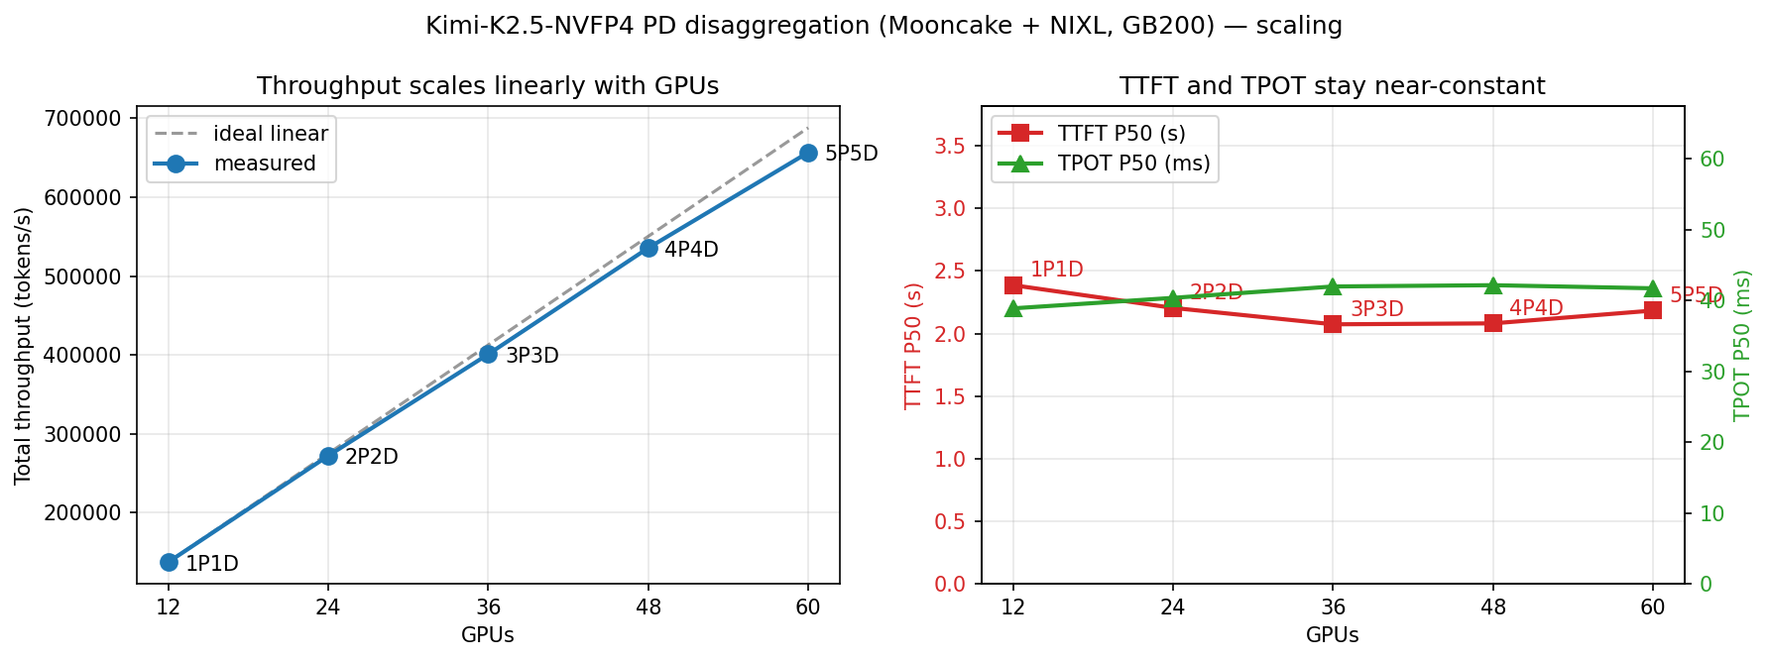
Mooncake x vLLM
3.8x vLLM Throughput
46x P50 TTFT reduced
8.6x E2E Latency reduced
near-linearly scalability
[1] https://vllm.ai/blog/mooncake-store

Slide 14
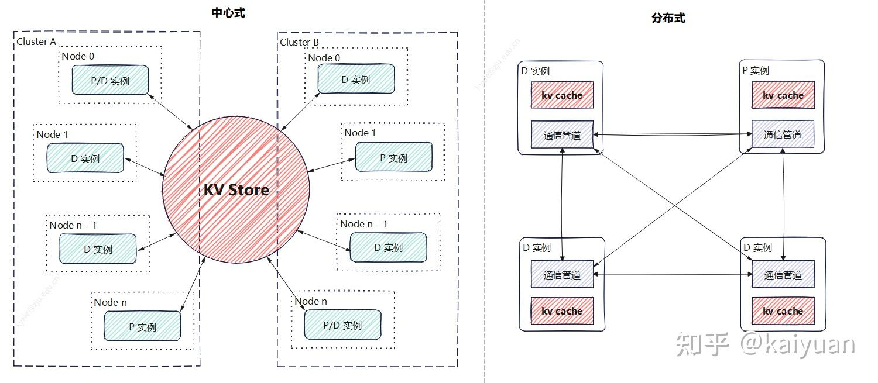
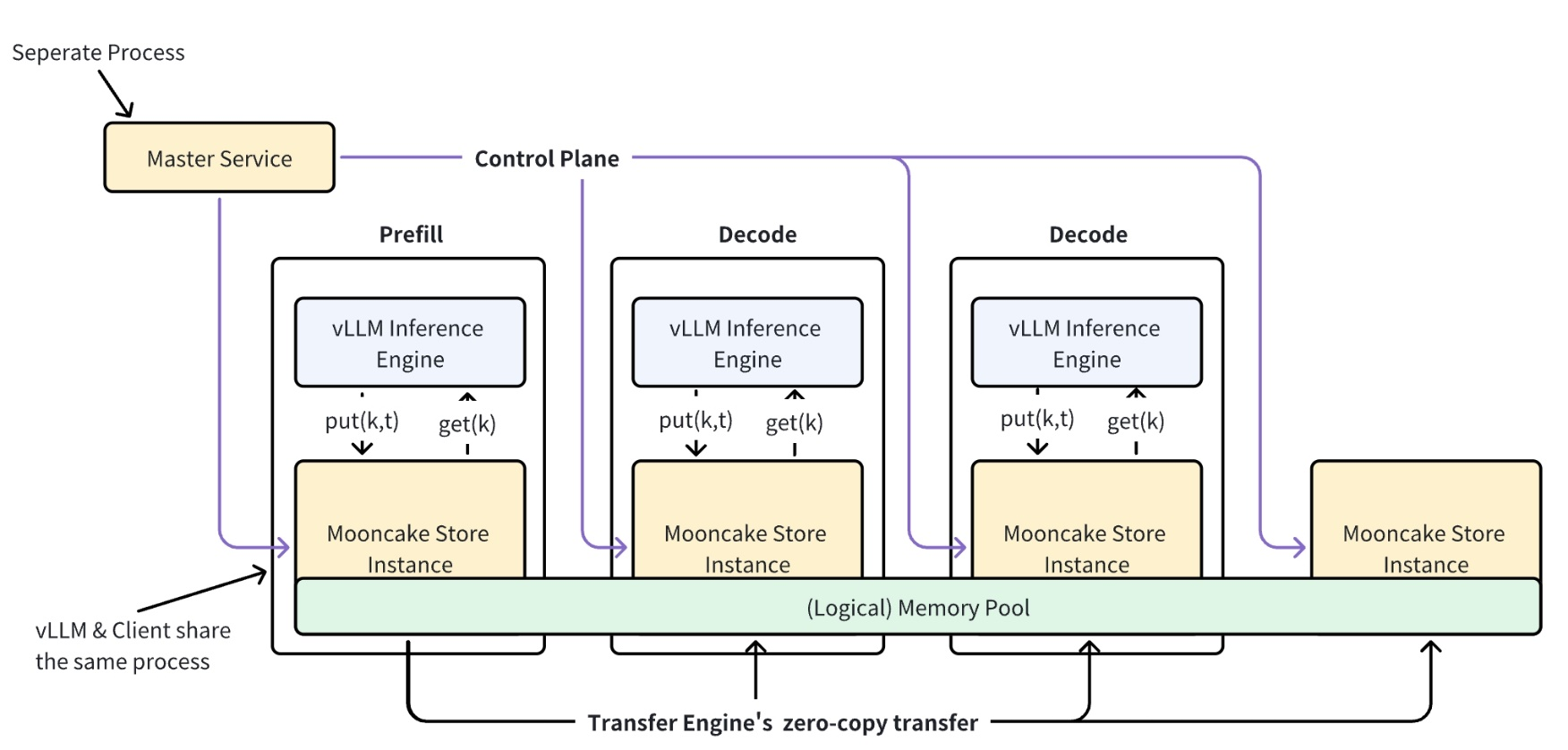
Mooncake x vLLM: The Past, The Present, The Future
Mooncake Support for vLLM v0
- Disaggregated serving supported
1p1d in 1st Version
XpYd in 2nd Version
Mooncake Support for vLLM v1
- Distributed KV cache supported
- Disaggregated serving w/ LMCache
Mooncake Support for vLLM v1
- Distributed KV cache pool supported
Mooncake Support for vLLM
- A new connector in the near future
(Owner + Request-Only Worker)
Mooncake Support for vLLM
Mooncake x llm-d
prefix-aware routing in clusters
.....

Slide 15
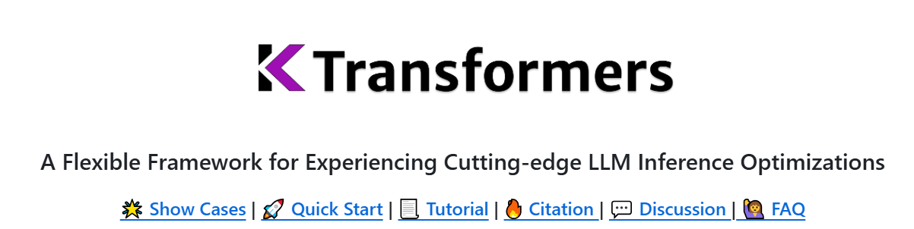


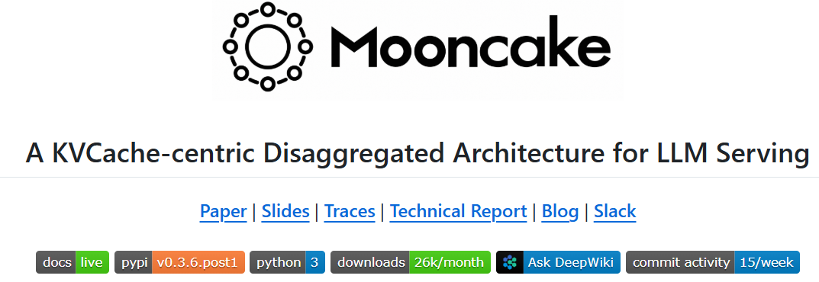
Join Us
We embrace open source software to push the boundaries of LLM innovation, together with YOU!
Approaching.AI, founded in late 2023, focuses on LLM inference optimization, helping enterprises deploy and utilize LLM at low cost. As a pioneer in accelerating LLM inference, Approaching.AI is dedicated to making AI deployment accessible to everyone.
职位详情
HR联系方式

Slide 16
Building High-Performance Inference Clusters in the Era of Agentic AI
vLLM Meetup, Hangzhou
Thanks!
Q & A
Use in vLLM
GitHub
Contact: lujhcoconut@foxmail.com

